Slide 1

Exporting Data from : Using the REDCapR package to export data using the REDCap API
Thomas Wilson, MPH
Center on Child Abuse and Neglect
Department of Pediatrics, OUHSC
MIECHV Paper Discussion
April 7, 2014

Slide 2
Presentation Outline
REDCap Overview and OUHSC History
Scenarios Favoring REDCap
REDCap & Reproducible Research
REDCap Data Export Options
Data Export Tool
Data Export API
API Data Export Example
REDCapR
REDCapR API Example

Slide 3
REDCap overview (http://project-redcap.org/)
Secure web application for building and managing surveys and databases.
Developed by informatics core at Vanderbilt with support from NCRR and NIH.
Designed for academic biomedical researchers.
Provides:
A centralized, back-end storage component.
Tools to create an interactive front-end html GUI.
An API to import & export data.
Example templates.
Instructional videos for training.
User-group network of institutional researchers.
Also included: built-in project calendar, scheduling module, ad hoc reporting tools, and advanced features, such as branching logic, file uploading, and calculated fields.
It can reduce
Developing a lot of new software applications.
Anxieties related to security of home-grown software.

Slide 4
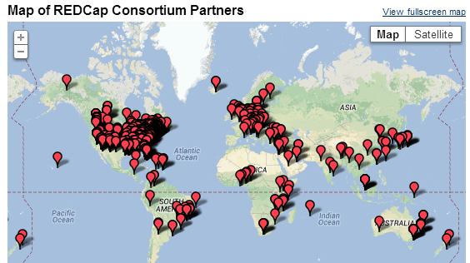
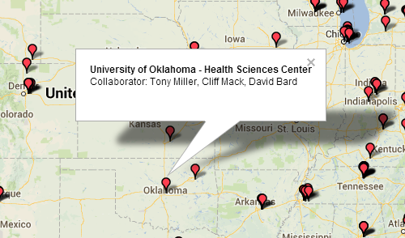
OUHSC Becomes REDCap Partner
MIECHV grant (DBP) requests REDCap (Nov. 2011)
IT installs “DBP” REDCap instance, ver.4 (Jan. 2012)
New DBP projects move to REDCap (2012-2013)
Campus REDCap interest rises (2012-2013)
IT installs “Enterprise” REDCap instance, ver.5 (Mar. 2013)
IT installs “Development box” instance, ver.5 (Apr. 2013)
Governance body requested (Mar. 2013)
Governance body formed (Jun. 2013)
Funding for REDCap admin requested (Apr. 2013)
College of Medicine agrees to fund Dev box and Enterprise instance (Jun. 2013)
Notes:
670 active partners in 56 countries as of June 2013
70,000 projects and 92,000 users

Slide 5
Scenarios Favoring REDCap
No professional software developer on the project
There’s nothing magical about REDCap; it accommodates the designs and needs of many clinical projects.
To develop a comparable system from scratch, you’d need experience with several technologies.
There are lots of dimensions and trade-offs when designing clinical research, and REDCap is close to the sweet spot for most designs.
Candidate for replacing Access, Survey Monkey, Excel.
REDCap is a good choice for data collection and management.

Slide 6
REDCap & Reproducible Research
An article about computational science in a scientific publication is not the scholarship itself, it is merely advertising of the scholarship. The actual scholarship is the complete software development environment and the complete set of instructions which generated the figures.
—D. Donoho

Slide 7
REDCap & Reproducible Research
Why is there a need for reproducible research?
Reproducible research embraces the concept that research is not only the scientific findings, but it is also the complete computational environment that was used to produce the results. This includes details such as the analytical code, data, etc.

Slide 8
REDCap & Reproducible Research
Designed for data collection and management
Has very limited reporting capabilities
Analytic capabilities are limited to univariate summary statistics and plots
REDCap used in conjunction with R is capable of producing sophisticated reproducible reports and analysis

Slide 9
REDCap Data Export Options
REDCap offers two methods for data extraction
The data export tool
Application Programming Interface (API)

Slide 10
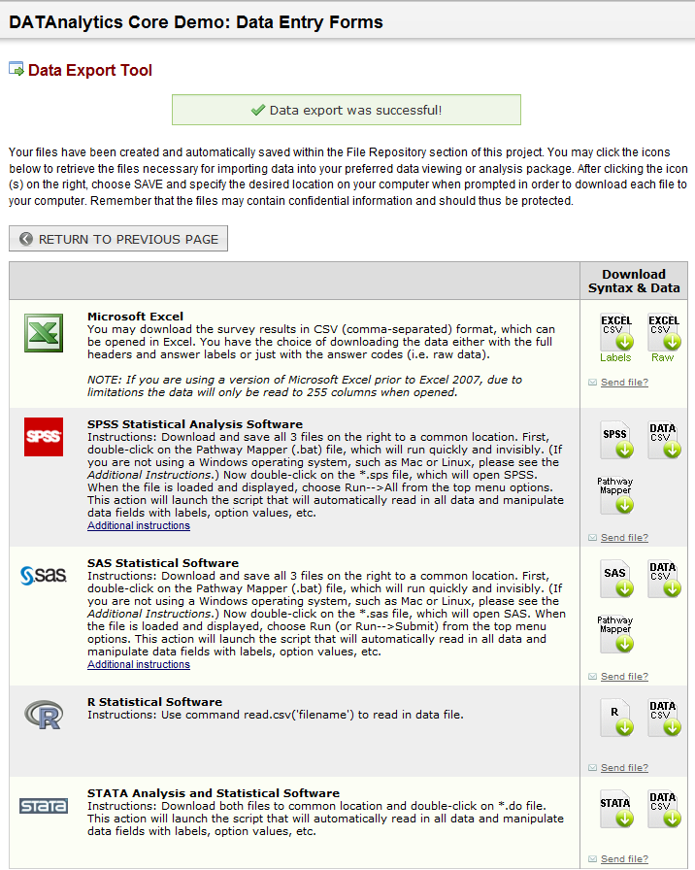
Data Export Tool
Clickable interface embedded in each project
Project specific
Exports data in five formats (Excel .csv, SPSS, SAS, R, and STATA)
Two options using the data export tool
Simple Data Export: exports entire data set with one click
Advanced Data Export: users choose which
fields to export and has
de-identification options
Manual interaction with REDCap
to retrieve data
Available export formats

Slide 11
Data Export Tool
Using the REDCap data export tool in conjunction with R, a user would have to perform the data export within REDCap, save the file to a secure folder, and then use the following code to create a data.frame in R.
#############################
### Reading a CSV file into R
#############################
pathInFilename <- “c:\\bigfolder\\notasbigfolder\\smallfolder\\smallerfolder\\REDCapfile.csv”
ds <- read.csv(file=pathInFilename, stringsAsFactors=FALSE)
Negatives
Manual Process to create file
Potentially exposes the location(s) of study data

Slide 12
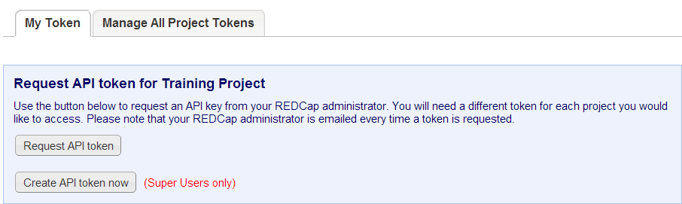
Data Export API
Programmatic data retrieval
Users must have approved API privileges in the User Rights section of REDCap
Tokens utilized as unique identifiers for an application requesting access to REDCap
REDCap superusers can create their own tokens
REDCap users with API privileges can request a token be created
API tokens are project and user specific
Offers a higher level of data security
Allows reports to be created dynamically (on the fly)

Slide 13
API Data Export Example
#############################
### Retrieve token and REDCap URL
#############################
dsnName <- "NothingToSeeHere"
channel <- RODBC::odbcConnect(dsnName) #getSqlTypeInfo("Microsoft SQL Server") #odbcGetInfo(channel)
redcapUri <- RODBC::sqlQuery(channel, "EXEC Security.prcUri @UriName = 'ABCD1'", stringsAsFactors=FALSE)[1, 'Value']
token <- RODBC::sqlQuery(channel, "EXEC [Security].[prcRedcapToken] @RedcapProjectName = 'NullResearchProject'", stringsAsFactors=FALSE)[1, 'Token']
RODBC::odbcClose(channel)
# Removes the channel and the dsnName
rm(channel, dsnName)
#############################
### Query REDCap API
#############################
#Call REDCap
system.time(gcFirst=T, expr={
rawCsvText <- RCurl::postForm(
uri=redcapUri,
token=token,
content='record',
format='csv',
type='flat',
.opts=curlOptions(cainfo="./Dal/Certs/ca-bundle.crt")
# .opts=curlOptions(ssl.verifypeer=FALSE)
)
})
# head(rawCsvText) #Inspect the raw data, if desired.
ds <- read.csv(text=rawCsvText, stringsAsFactors=FALSE) #Convert the raw text to a dataset.
ds$RowID <- as.integer(row.names(ds))
object.size(ds)
rm(redcapUri, token, rawCsvText)

Slide 14
REDCapR
What is this REDCapR you speak of?
Written by Will Beasley, REDCapR is an R package containing the functions redcap_read_oneshot, redcap_read, and redcap_write.
These functions communicate with REDCap using its API capabilities.

Slide 15
REDCapR
redcap_read_oneshot: retrieves data all at once from REDCap
redcap_read: retrieves data in subsets and then combines them into a single data.frame
redcap_write: writes data to REDCap (data import)

Slide 16
REDCapR
Usage
redcap_read(batch_size = 100L, interbatch_delay = 0, redcap_uri, token, records = NULL, records_collapsed = NULL, fields = NULL, fields_collapsed = NULL, export_data_access_groups = FALSE, raw_or_label = "raw", verbose = TRUE, cert_location = NULL)
All arguments of the redcap_read function will be discuss, however it should be noted that not all arguments are required. This function can be used with a statement as simple as:
redcap_read(redcap_uri, token)

Slide 17
REDCapR
Usage
redcap_read(batch_size = 100L, interbatch_delay = 0, redcap_uri, token, records = NULL, records_collapsed = NULL, fields = NULL, fields_collapsed = NULL, export_data_access_groups = FALSE, raw_or_label = "raw", verbose = TRUE, cert_location = NULL)
batch_size: The maximum number of subject records a single batch should
contain. The default is 100.

Slide 18
REDCapR
Usage
redcap_read(batch_size = 100L, interbatch_delay = 0, redcap_uri, token, records = NULL, records_collapsed = NULL, fields = NULL, fields_collapsed = NULL, export_data_access_groups = FALSE, raw_or_label = "raw", verbose = TRUE, cert_location = NULL)
interbatch_delay: The number of seconds the function will wait before
requesting a new subset from REDCap. The default
is 0.5 seconds

Slide 19
REDCapR
Usage
redcap_read(batch_size = 100L, interbatch_delay = 0, redcap_uri, token, records = NULL, records_collapsed = NULL, fields = NULL, fields_collapsed = NULL, export_data_access_groups = FALSE, raw_or_label = "raw", verbose = TRUE, cert_location = NULL)
redcap_uri: The URI of the REDCap project. Required.
Note: In computing, a uniform resource identifier (URI) is a string of characters used to identify a name of a web resource. Such identification enables interaction with representations of the web resource over a network (typically the World Wide Web) using specific protocols.

Slide 20
REDCapR
Usage
redcap_read(batch_size = 100L, interbatch_delay = 0, redcap_uri, token, records = NULL, records_collapsed = NULL, fields = NULL, fields_collapsed = NULL, export_data_access_groups = FALSE, raw_or_label = "raw", verbose = TRUE, cert_location = NULL)
token: The user-specific string that serves as the password for a project. Required.

Slide 21
REDCapR
Usage
redcap_read(batch_size = 100L, interbatch_delay = 0, redcap_uri, token, records = NULL, records_collapsed = NULL, fields = NULL, fields_collapsed = NULL, export_data_access_groups = FALSE, raw_or_label = "raw", verbose = TRUE, cert_location = NULL)
records: An array, where each element corresponds to the ID of a desired
record. Optional.

Slide 22
REDCapR
Usage
redcap_read(batch_size = 100L, interbatch_delay = 0, redcap_uri, token, records = NULL, records_collapsed = NULL, fields = NULL, fields_collapsed = NULL, export_data_access_groups = FALSE, raw_or_label = "raw", verbose = TRUE, cert_location = NULL)
records_collapsed: A single string, where the desired ID values are separated
by commas. Optional.

Slide 23
REDCapR
Usage
redcap_read(batch_size = 100L, interbatch_delay = 0, redcap_uri, token, records = NULL, records_collapsed = NULL, fields = NULL, fields_collapsed = NULL, export_data_access_groups = FALSE, raw_or_label = "raw", verbose = TRUE, cert_location = NULL)
fields: An array, where each element corresponds to a desired project field.
Optional.

Slide 24
REDCapR
Usage
redcap_read(batch_size = 100L, interbatch_delay = 0, redcap_uri, token, records = NULL, records_collapsed = NULL, fields = NULL, fields_collapsed = NULL, export_data_access_groups = FALSE, raw_or_label = "raw", verbose = TRUE, cert_location = NULL)
fields_collapsed: A single string, where the desired field names are separated by
commas. Optional.

Slide 25
REDCapR
Usage
redcap_read(batch_size = 100L, interbatch_delay = 0, redcap_uri, token, records = NULL, records_collapsed = NULL, fields = NULL, fields_collapsed = NULL, export_data_access_groups = FALSE, raw_or_label = "raw", verbose = TRUE, cert_location = NULL)
export_data_access_groups: A boolean value that specifies whether or
not to export the “redcap_data_access_group”
field when data access groups are utilized in the
project. Default is FALSE.

Slide 26
REDCapR
Usage
redcap_read(batch_size = 100L, interbatch_delay = 0, redcap_uri, token, records = NULL, records_collapsed = NULL, fields = NULL, fields_collapsed = NULL, export_data_access_groups = FALSE, raw_or_label = "raw", verbose = TRUE, cert_location = NULL)
raw_or_label: A string (either ‘raw’ or ‘label’) that specifies whether to export
the raw coded values or the labels for the options of multiple
choice fields. Default is ‘raw’.

Slide 27
REDCapR
Usage
redcap_read(batch_size = 100L, interbatch_delay = 0, redcap_uri, token, records = NULL, records_collapsed = NULL, fields = NULL, fields_collapsed = NULL, export_data_access_groups = FALSE, raw_or_label = "raw", verbose = TRUE, cert_location = NULL)
verbose: A boolean value indicating if messages should be printed
to the R console during the operation. Optional.

Slide 28
REDCapR
Usage
redcap_read(batch_size = 100L, interbatch_delay = 0, redcap_uri, token, records = NULL, records_collapsed = NULL, fields = NULL, fields_collapsed = NULL, export_data_access_groups = FALSE, raw_or_label = "raw", verbose = TRUE, cert_location = NULL)
cert_location: If present, this string should point to the location of cert
files required for SSL verification. If the value is missing or NULL,
the server’s identity will be verified using a recent CA bundle
from the cURL website. Optional.

Slide 29
REDCapR
Details
Specifically, REDCapR internally uses multiple calls to redcap_read_oneshot to select and return data. Initially, only primary key is queried through the REDCap API. The long list is then subsetted into partitions, whose sizes are determined by the batch_size parameter. REDCap is then queried for all variables of the subset’s subjects. This is repeated for each subset, before returning a unified data.frame. The function allows a delay between calls, which allows the server to attend to other users’ requests.

Slide 30
REDCapR
redcap_write(ds_to_write, batch_size = 10L, interbatch_delay = 0, redcap_uri, token, verbose = TRUE)
This function contains many similar arguments to redcap_read. The new argument, ds_to_write, is the R data.frame that is going to be imported into a REDCap project.

Slide 31
REDCapR API Example
Using the redcap_read() function data can be extracted from REDCap with only one line

Slide 32
REDCapR API Example
Simple REDCapR example using the default settings.
ds <- redcap_read(redcap_uri=uri, token=token)$data
User must supply the two required parameters:
uri and token

Slide 33
REDCapR API Example
REDCapR example returning only records with IDs of 1 and 4.
desired_records <- c(1, 4)
ds_some_rows <- redcap_read( redcap_uri = uri, token = token, records = desired_records )$data

Slide 34
REDCapR API Example
REDCapR example returning only the fields recordid, first_name, and age.
desired_fields <- c("recordid", "first_name", "age")
ds_some_fields <- redcap_read( redcap_uri = uri, token = token, fields = desired_fields )$data

